Slide 1

COMPREHENSIVE GUIDE
Detecting
Fake News
Identification, Detection, and Prevention in the Digital Age
Detection
Analysis
Education

Slide 2
OVERVIEW
Contents
01
Understanding the Problem
Defining fake news and the modern information crisis
02
Types of Misinformation
Categorizing deceptive content
03
The Impact
Real-world consequences of misinformation
04
Detection Methods
Technological and analytical approaches
05
Prevention Strategies
Building resilience against misinformation

Slide 3
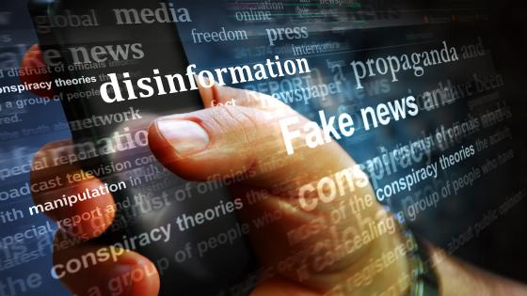
CHAPTER ONE
01
Understanding
the Problem
Defining fake news and the modern information crisis

Slide 4
UNDERSTANDING THE PROBLEM
The Fake News Ecosystem
What Constitutes Fake News?
Primary Distribution Channels
Fake news encompasses deliberately false or misleading information designed to deceive readers, often for political, financial, or ideological gain. It mimics legitimate journalism but lacks factual basis and credible verification.
Social Media Platforms
Facebook, Twitter/X, and Instagram enable rapid viral sharing through algorithmic amplification and echo chambers.
Messaging Apps
Misinformation
Disinformation
Malinformation
WhatsApp, Telegram, and WeChat facilitate private group sharing, making fact-checking difficult.
False info spread without harmful intent
False info created to cause harm
Genuine info used to inflict harm
Fake News Websites
Designed to mimic legitimate outlets with deceptive URLs and professional layouts.
The Scope of the Crisis
6x
Faster Spread
83%
Exposure Rate
Fake news spreads 6 times faster than real news on social media platforms, reaching 1,500 people 6x quicker than legitimate stories.
83% of adults in developed nations report regularly encountering fake news online.
Why It Matters
The democratization of information has created a parallel democratization of deception. Understanding this ecosystem is the first step toward building effective detection capabilities.

Slide 5

CHAPTER TWO
02
Types of
Misinformation
Categorizing deceptive content

Slide 6
TYPES OF MISINFORMATION
The Misinformation Spectrum
Seven fundamental types of deceptive content
01
Satire or Parody
02
False Connection
03
Misleading Content
Content with no intention to cause harm but can fool readers, using humor or exaggeration to critique.
Headlines, visuals, or captions don't support the content, creating misleading associations.
Genuine information framed misleadingly through selective quotes, manipulated statistics, or visual misrepresentation.
04
False Context
05
Imposter Content
06
Manipulated Content
Genuine content shared with false contextual information like incorrect dates, locations, or event framing.
Impersonates genuine sources, using familiar branding or names to deceive. Check URLs for discrepancies.
Genuine content altered via Photoshop, deepfakes, or editing to change meaning or create false impressions.
07
Fabricated Content
Content that is 100% false , designed to deceive and do harm. Completely invented events, quotes, and evidence.
Critical Insight: Research shows that misleading content and false context are the most difficult to detect, requiring subject-matter expertise to identify subtle misrepresentations.

Slide 7
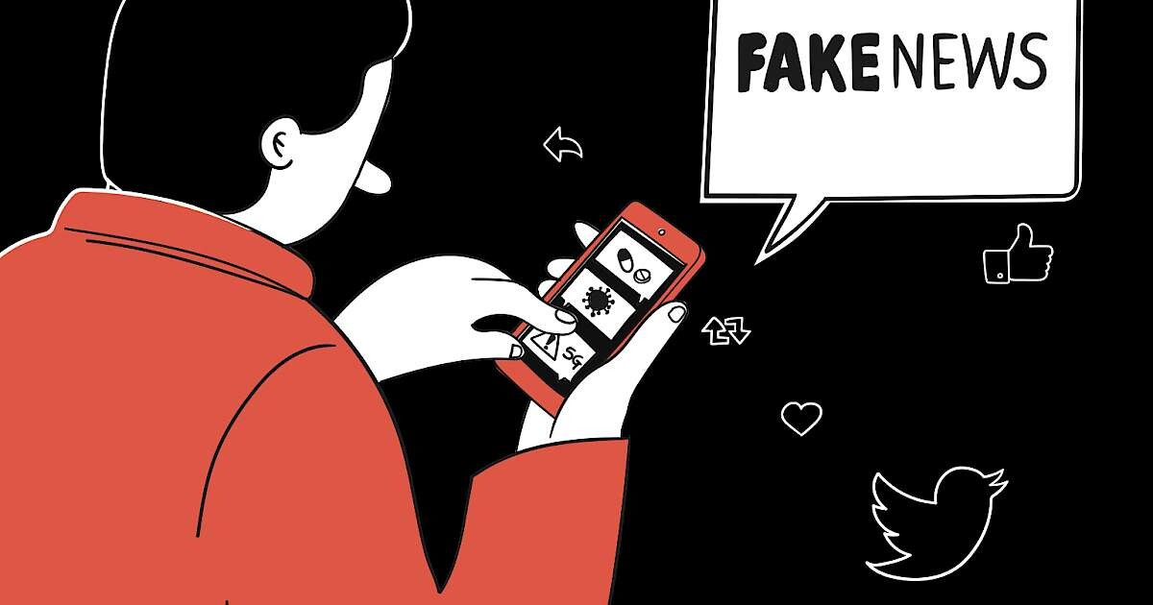
CHAPTER THREE
03
The
Impact
Real-world consequences of misinformation

Slide 8
THE IMPACT
Societal Consequences
How fake news shapes our world
Public Health Crisis
Democratic Erosion
Fake health news has devastating consequences , causing confusion, panic, and harmful behaviors.
Misinformation undermines democratic processes by manipulating public opinion and voter behavior.
COVID-19 misinformation led to vaccine hesitancy and ineffective treatments
Voter suppression tactics using false voting information
False health claims can reverse decades of progress in disease eradication
Foreign interference campaigns exploit social media to sow division
Social Polarization
Economic Damage
Fake news creates deep societal fractures by reinforcing echo chambers and eroding trust.
Misinformation causes significant financial harm through market manipulation and consumer deception.
Algorithmic amplification creates ideological bubbles
Stock market volatility from false financial rumors
Trust erosion extends to all institutions, destabilizing society
Cryptocurrency scams and pump-and-dump schemes
Critical Finding: The multi-domain impact creates feedback loops. Health misinformation affects politics, political misinformation affects markets, and economic misinformation affects social cohesion.

Slide 9
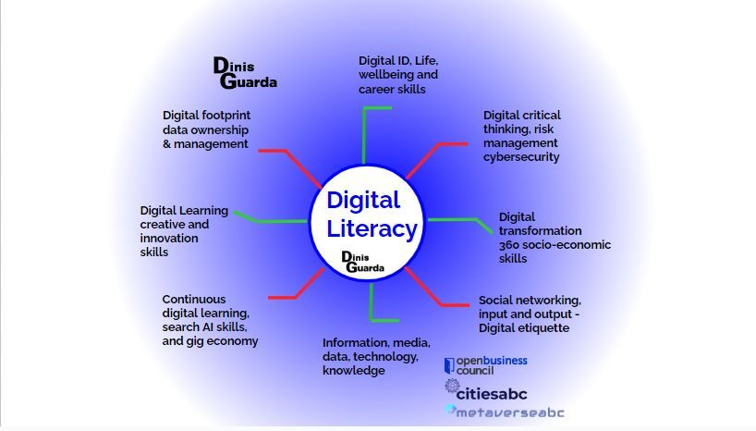
CHAPTER FOUR
04
Detection
Methods
Technological and analytical approaches

Slide 10
DETECTION METHODS
AI-Powered Detection Technologies
State-of-the-art approaches achieving up to 96.5% accuracy
Multimodal Analysis
Cross-Modal Fusion
Modern AI integrates multiple data modalities to detect subtle inconsistencies across text, images, videos, and audio.
Advanced attention mechanisms detect inconsistencies between modalities, revealing manipulated content.
Text
Images
Key Capabilities
BERT, RoBERTa, GPT
ResNet, Vision Transformers
▸
Align visual evidence with textual claims at granular levels
Video
Audio
▸
Identify manipulated images paired with misleading headlines
SlowFast, 3D-CNNs, CLIP
1D-CNNs, ResNet-1D
Large Language Models
Graph Neural Networks
LLMs bring reasoning capabilities for complex verification and fact-checking with few-shot learning.
GNNs analyze social media propagation patterns , tracking how information spreads through user networks.
BERT-Based
Hybrid Models
Model user relationships and information pathways
84%
96.5%
Identify influential spreaders and bot networks
F1 Score
Accuracy
Performance: State-of-the-art models now achieve 96.5% accuracy on benchmark datasets, a dramatic improvement from early models at ~56%.

Slide 11
DETECTION METHODS
Source Credibility Assessment
Practical frameworks for evaluating information sources
The CRAAP Test Framework
Lateral Reading
Developed by librarians at California State University, this systematic approach evaluates sources across five critical dimensions .
Professional fact-checkers' technique : research the source and claims via other sources.
1
Research the source: Look up site/author credibility
2
Check the claims: Verify with reliable sources
Currency
Relevance
Authority
Accuracy
Purpose
Timeliness of information
Importance for your needs
Source credibility
Reliability & truthfulness
Reason for existing
Red Flags Checklist
ALL CAPS headlines
Emotional manipulation
No named authors
When published?
Target audience?
Credentials?
Evidence?
Biases?
Educational Impact: Teaching these frameworks significantly improves discernment of true from false news.

Slide 12
DETECTION METHODS
Detection Tools and Platforms
Practical solutions for real-time verification
Google Fact Check Tools
The Factual
Search engine integration
AI-powered credibility scoring
Fact Check Explorer
Evaluates 10,000+ stories daily via app, extension, and website, grading articles on credibility factors.
Search engine for fact-checks. Enter a claim to see verdicts from multiple organizations.
A+
B
C
D
Fact Check Markup Tool
High Quality
Good
Fair
Poor
Allows fact-checkers to add structured data tags for search engines to recognize and display.
Logically
Hybrid AI + human fact-checking
Monitors 1M+ domains in real-time, combining AI with expert fact-checkers for comprehensive verification.
Specialization: Political claims, image verification, and event analysis.
Archive.org Wayback Machine
Historical web archiving
Deepfake Detection
Browse archived versions of web pages to see if content has been altered.
Advanced tools use PRNU camera fingerprints to trace video origins and authenticate content.
Use cases: Verify deleted content, track page changes, and access removed articles.
Integration is Key: The most effective approach combines automated AI screening with human expert verification .

Slide 13
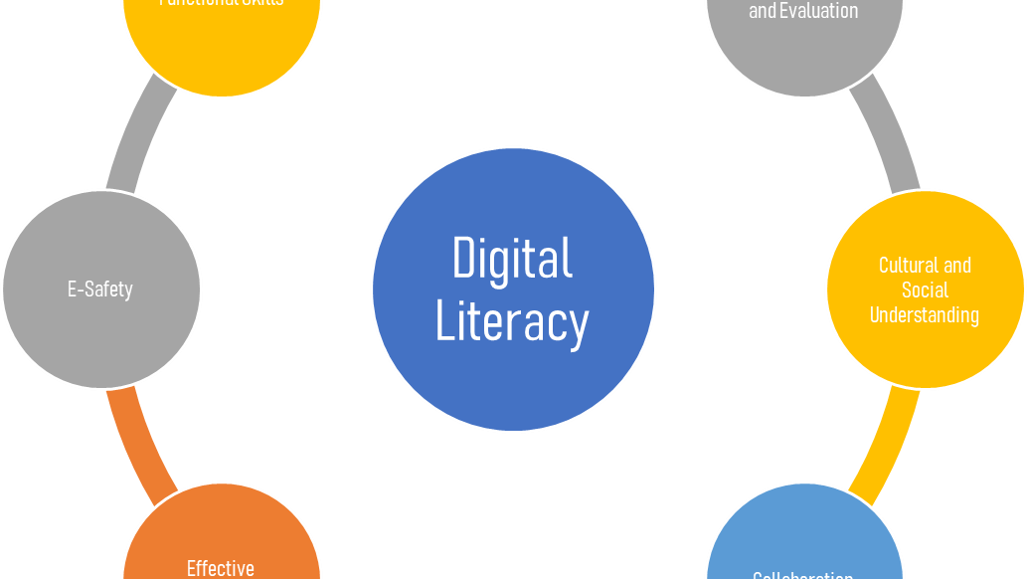
CHAPTER FIVE
05
Prevention
Strategies
Building resilience against misinformation

Slide 14
PREVENTION STRATEGIES
Media Literacy Education
Evidence-based approaches to building resilience
Proven Educational Interventions
Multi-Layered Strategy
Studies show that structured media literacy education significantly reduces susceptibility to misinformation.
The most effective approach addresses multiple levels simultaneously —individual, organizational, and societal.
+35%
+42%
-28%
1
Individual (Micro)
Improvement in discernment accuracy
Increase in fact-checking behavior
Reduction in sharing intent
Personal skills, critical thinking, verification habits
2
Organizational (Meso)
Key Educational Components
Newsroom policies, platform design, library programs
Critical thinking: Logic, reasoning, cognitive bias recognition
Fact-checking: Verification techniques, reverse image search
Lateral reading: Professional fact-checker methodology
Responsible sharing: Pause-before-sharing protocols
Key Success Factors
Interventions are most effective when they are ongoing, not one-time ; incorporate active learning ; and address emotional manipulation tactics.
Collaborative Approaches
Effective prevention requires multi-stakeholder collaboration across educational institutions, libraries, media, and tech platforms.
Educational institutions: Integrate media literacy into core curricula at all levels

Slide 15
THE PATH FORWARD
Empowering Information
Consumers
The future of fake news detection lies in the combination of advanced AI technologies , comprehensive education , and active citizen engagement .
By understanding detection methods and developing critical media literacy, we can collectively build a more resilient information ecosystem.
Detect
Educate
Empower
Advanced AI and analytical tools
Build critical thinking skills
Citizens as active defenders
The responsibility to verify information before sharing is everyone's duty in the digital age.

